Slide 1
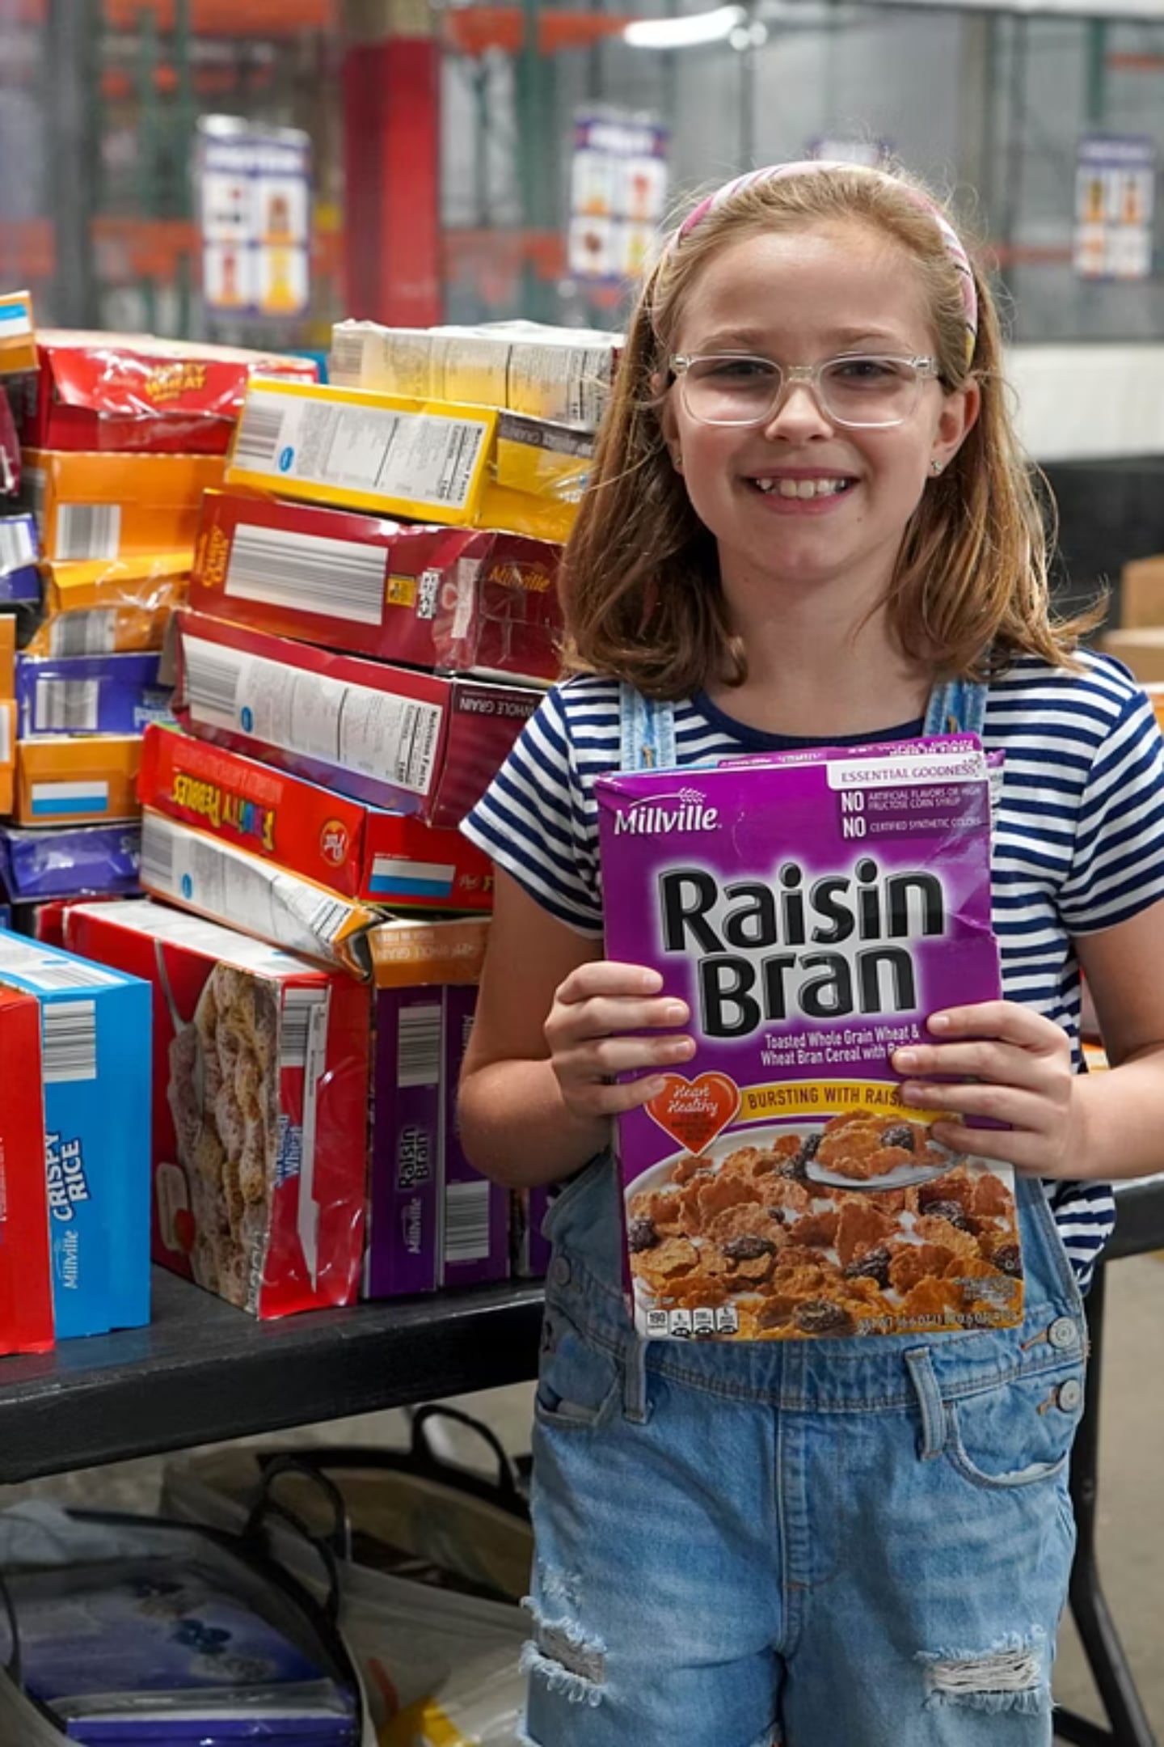

Second Harvest Food Bank
Clark, Champaign & Logan Counties — Annual Report 2025

Slide 2
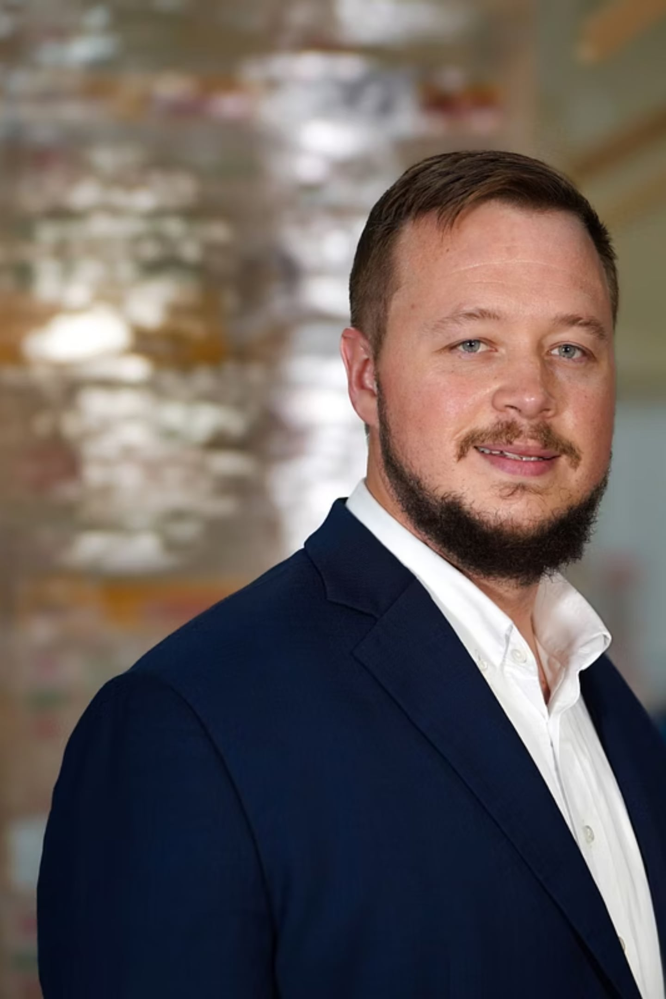
A Message from Our Executive Director
Alex Jackson
This past year reminded us, again, why this work matters. Across Clark, Champaign, and Logan County, neighbors faced rising costs, economic uncertainty, and difficult choices; and Second Harvest was there. Every meal distributed, every volunteer hour, every generous donation represents our community's collective commitment to one another. I am deeply grateful for the trust you place in us and inspired by what we accomplish together. Our mission has never been more vital.

Slide 3
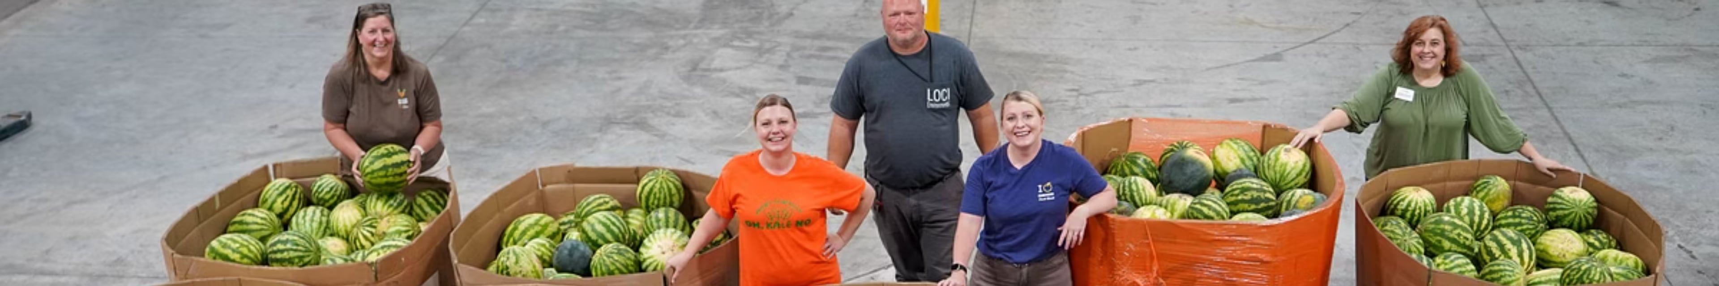
A Year of Challenge & Response
This year challenged both our food system and our determination.
Throughout our region, we faced higher food prices, fewer deliveries, and supply chain issues that made it harder to access essential staples. Meanwhile, more families came to Second Harvest for help. Even with these challenges, our community came together.
When food programs ended or were canceled, we adjusted. We found new ways to fund food purchases, strengthened existing partnerships, and focused on the most urgent needs in our network, like ensuring our partner agencies had the inventory they needed to feed our community.
When more people needed help, we were there. We organized pop-up distributions to address the disruption to SNAP benefits and served those who serve us by providing a special delivery to our military families.
Because of our donors, volunteers, and partners, we did more than react. We kept serving our community, no matter how many obstacles came our way.

Slide 4
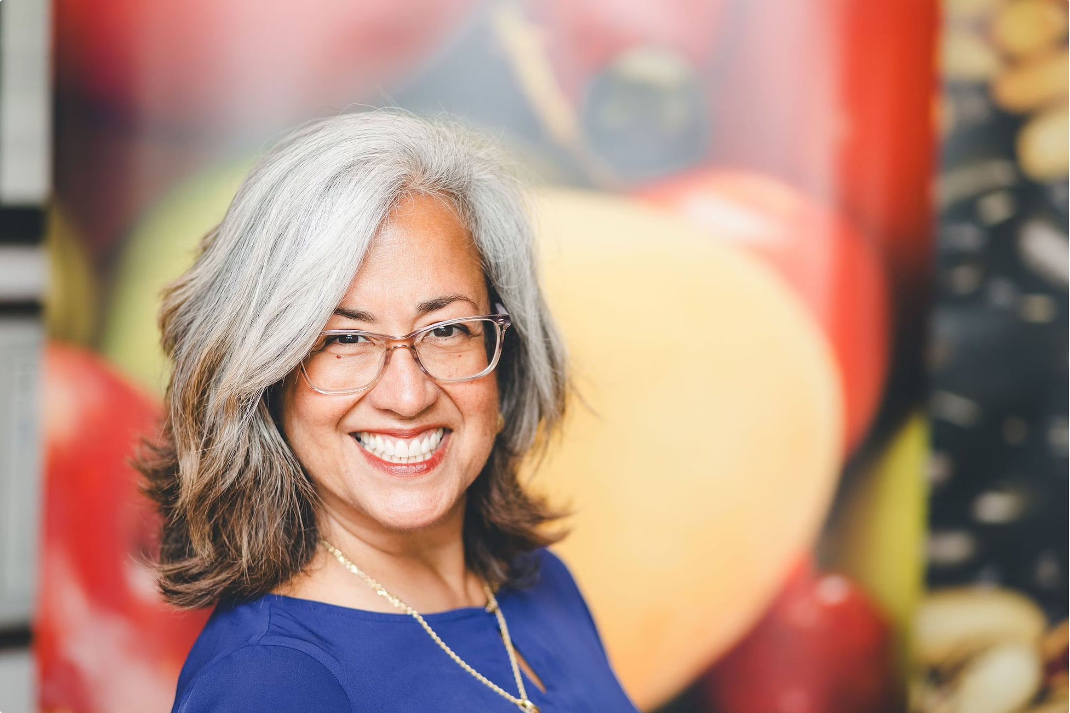

A Message from Our Board President
Dulce Hurst
Our Board remains steadfast in its commitment to strategic, mission-driven governance. This year, we deepened key community partnerships and strengthened the systems that ensure food reaches every neighbor who needs it. Fighting hunger in our communities is our daily purpose. We are proud of what this organization has accomplished and energized by the work still ahead.
Governance
Partnerships
Vision
Strategic oversight with accountability
Stronger collaboration across counties
A food-secure future for all neighbors

Slide 5
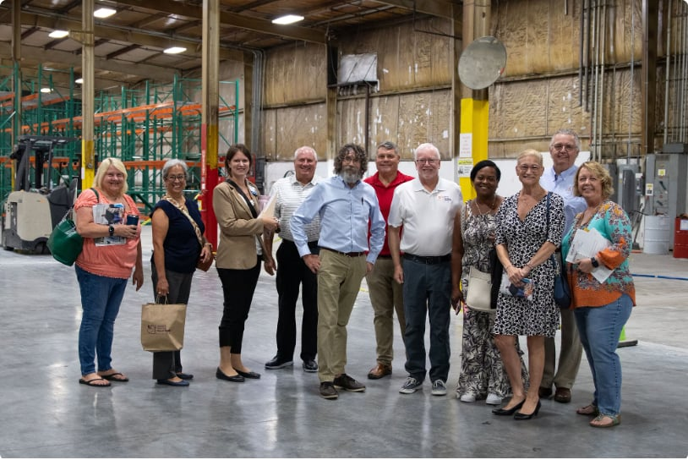
2025 Board of Directors
Dulce Hurst, President
Mary Jo Leventhal, Vice-President
Nancy Cavanaugh, Treasurer
Gracie Hemphill, Secretary
Zach Bayless
Nettie Carter-Smith
Mike Dinovo
Bill Johnson
Stephanie Novosad
Abby O'Connor
Steve Short
Becky Skiles Gorby

Slide 6
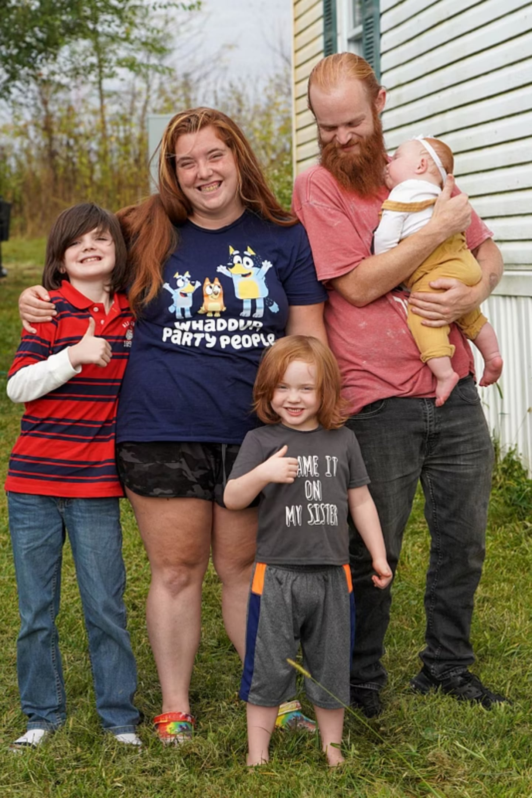
Neighbor Story
Making Ends Meet
Stories like Nikki and Scott’s became more common this year. As grocery prices climbed and budgets got tighter, more families, some who had never needed our help before, found themselves reaching out.
Thanks to donor support, partner pantries like Oasis of Mercy kept offering steady, reliable access to food, helping families get through tough times when it mattered most.
"Your help matters... know that you are helping our daughter and two sons eat when we can't do it."
Despite spending $900 a month on groceries, sometimes it's just not enough. When budgets get tight, Nikki and Scott of Mechanicsburg visit Oasis of Mercy, a Second Harvest partner agency. They receive bread, canned goods, frozen foods, and even baby formula. These essential items make it possible for the family to bridge the gaps between pay days.

Slide 7
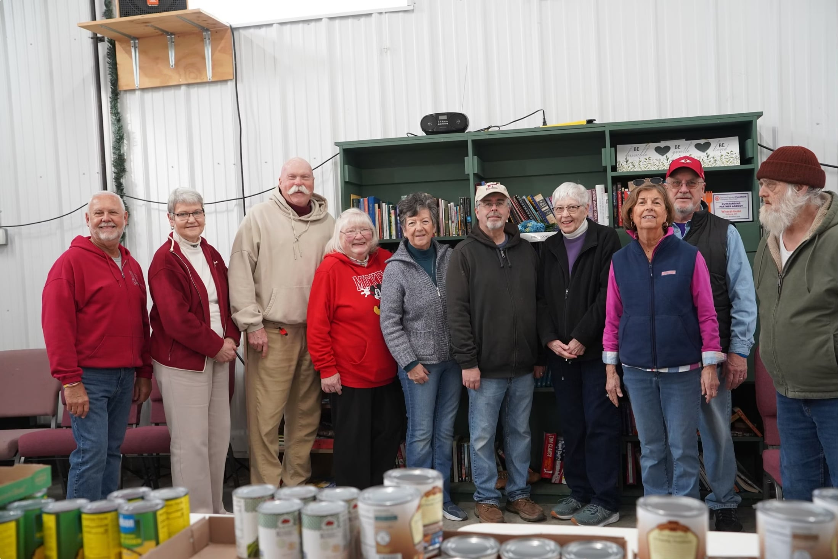

Partner Spotlight
Community in Action
The WhereHouse Food Pantry in Urbana is a valued partner of Second Harvest Food Bank, offering a friendly, caring space for neighbors in need. In addition to a pantry stocked with nutritious food, they offer our neighbors household essentials, hygiene products, and even books and games. They also host a free community dinner once a month which is open to everyone in the community.
Local Distribution
Unique Expertise
Collective Impact
Partner pantries operate on the front lines, meeting neighbors where they live
Each agency brings specialized knowledge of their community's needs
Together, our network reaches more neighbors than any single organization could alone

Slide 8
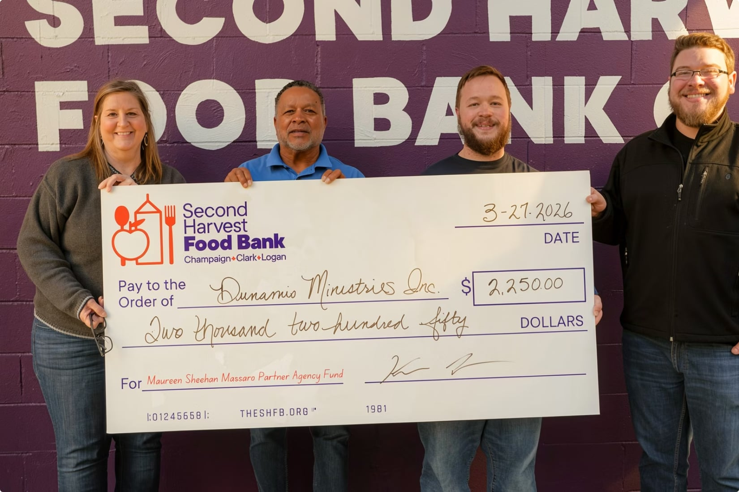
Strengthening Our Network: Investing in Partner Agencies
Our work does not end when food leaves our warehouse. It continues through the network of partner agencies who serve neighbors every day. That’s why we intentionally reinvest in the strength and sustainability of those partners.
Through the Maureen Sheehan Massaro Partner Agency Fund, we've provided direct support to dozens of partner pantries on the front lines of hunger relief. This fund offers partner agencies the opportunity to apply for capacity-building grants of up to $1,000 per request, with no limit on the number of applications. Whether upgrading equipment, expanding storage, or improving operations, these grants help agencies grow in ways that directly benefit the communities they serve.
This year, the fund also supported our entire network by subsidizing shared maintenance fees, ensuring agencies could remain focused on serving neighbors rather than managing rising operational costs. This approach reflects what we believe is full-circle support. We distribute food to our partners, and in turn, invest back into their ability to distribute it efficiently and effectively. By strengthening our partners, we strengthen the entire hunger-relief system.

Slide 9
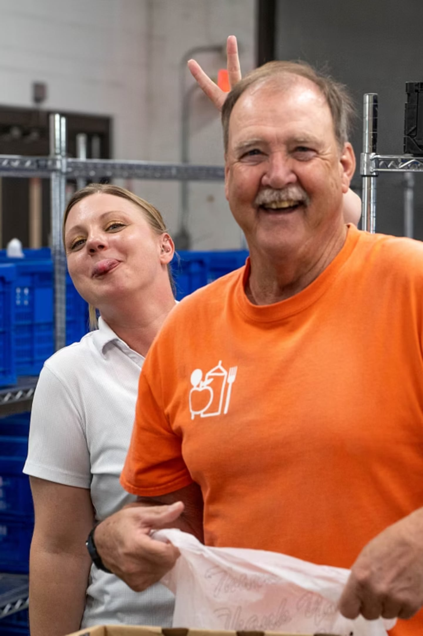
Volunteers: The Power Behind the Work
Every day, volunteers fuel our mission.
From sorting and packing food to supporting distributions and assisting partner agencies, their time and effort ensure that food moves quickly and efficiently to our neighbors across the region. In a year marked by unique challenges, volunteers played a critical role in helping us stay responsive, flexible, and focused on our mission.
Their impact goes far beyond the hours they give. Volunteers bring energy, care, and a shared commitment to community that strengthens every part of our work (plus they bring the FUN!). They help us extend our reach, maintain consistency during uncertain times, and serve more families with dignity and respect.
This year, 659 unique volunteers contributed 4,415 hours of service, representing an estimated $143,134 in community impact through volunteer labor. These numbers reflect more than efficiency; they represent a community choosing to show up for one another.
We are deeply grateful for the time, dedication, and heart our volunteers bring to this work every day.

Slide 10
Second Harvest Food Bank — 2025 by the Numbers
Our Impact: Meeting the Moment Together
Behind every number is a response to a need and a community that made it possible.
3.3 million meals distributed means families had food despite rising costs and uncertainty.
45,000 neighbors served reflects real people turning to Second Harvest for support.
4 million pounds of food required constant adaptation as supply fluctuated throughout the year.
4,400 volunteer hours ensured that even in challenging conditions, food continued moving efficiently to those who needed it most.
This impact did not happen by chance. It happened because supporters believe in the importance of our mission.
3.3M
45K
4M
4.4K
Meals Distributed
Neighbors Served
Pounds of Food
Volunteer Hours
Provided to individuals and families across our three-county service area
Unduplicated individuals reached in Clark, Champaign, and Logan counties
Including fresh produce, protein, dairy, and shelf-stable items
Contributed by dedicated community members who make it all possible

Slide 11
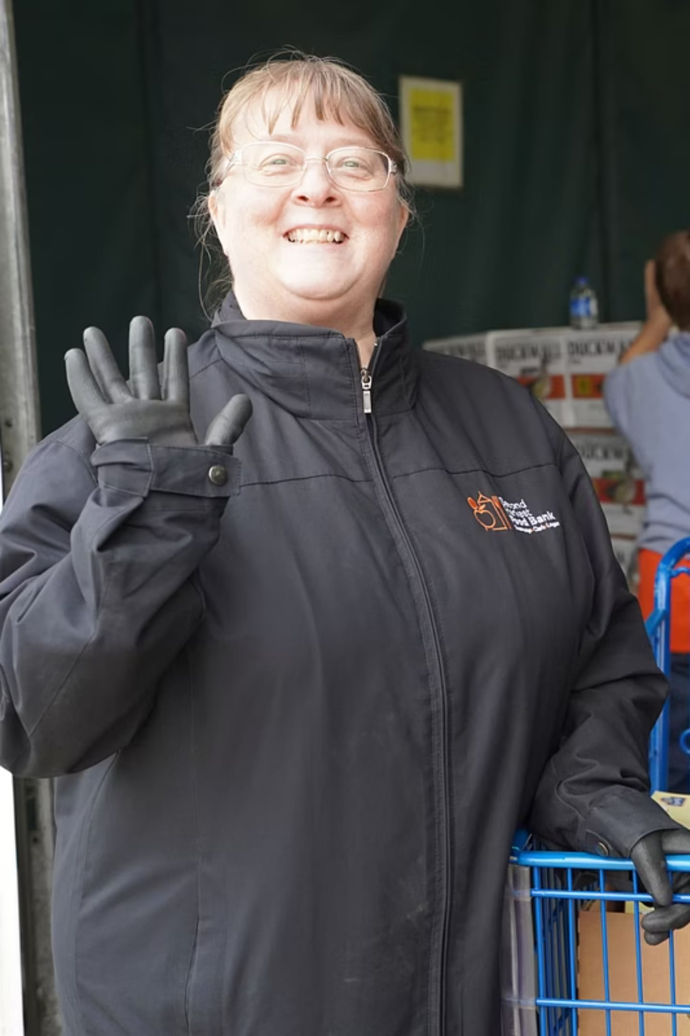
Investing in Stability During Uncertainty
This year required more than careful stewardship, it also required flexibility.
As donated food supply fluctuated and costs increased, financial support became even more critical. Contributions from individuals, events, grants, and government funding allowed us to:
Purchase food when our donated and government programs supply fell short
Maintain consistent distributions despite canceled loads
Support partner agencies facing increased demand
Every dollar became more powerful this year, helping us respond to challenges in real time while continuing to serve our community without interruption.

Slide 12
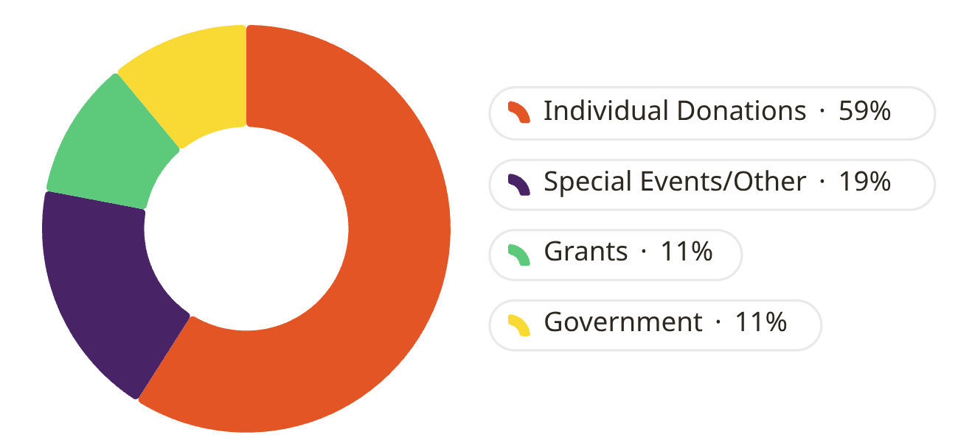

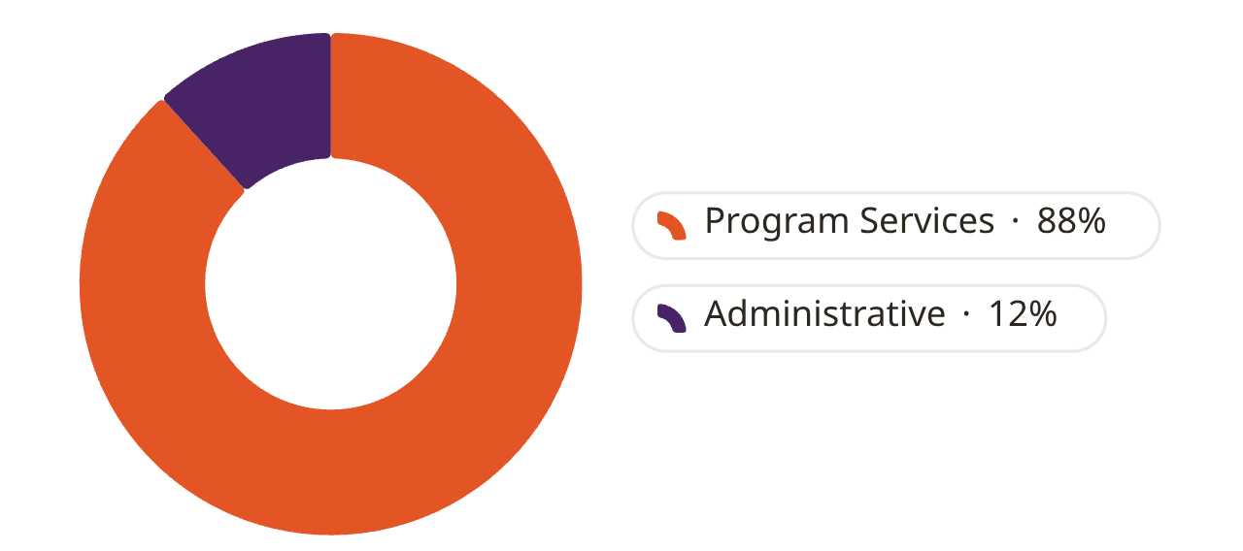
Second Harvest Food Bank — 2025
Financial Overview: Investing in Our Mission
Revenue: $12,783,039*
Where Every Dollar Goes
Program Services — 88%
Administrative — 12%
Operations, staffing, and fundraising
Direct food procurement, distribution, and community programs
Expenses: $12,369,428*
88 cents of every dollar goes directly to serving our neighbors in need.
*Unaudited financials

Slide 13
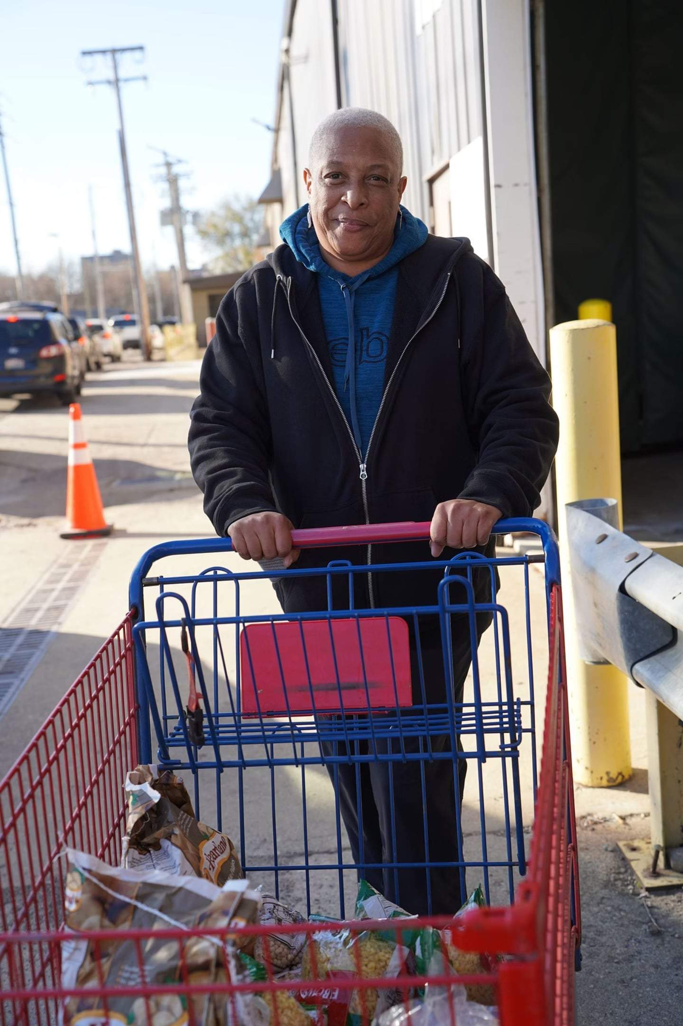



Looking Ahead
Our Commitment to a Food-Secure Future
Expanding Reach
Bringing our mobile distributions to underserved areas in our rural communities
Deepening Partnerships
Growing our partner agency network and investing in shared resources to strengthen the entire hunger-relief ecosystem
Advocating for Change
Beyond food distribution, we are amplifying our voice on policies that address the root causes of hunger in our region

Slide 14



From All of Us at Second Harvest
You Made this Year Possible
This was not an easy year. That makes your support even more meaningful.
Contact Us
Website
To our donors, volunteers, partner agencies, board members, and community champions: your support makes this work possible. Because of your commitment, seniors on fixed incomes can count on groceries, parents can stretch their budgets, and children can get the nutrition they need to learn and grow. Whether you give your time, resources, or voice, you are part of a community that shows up for its neighbors. We are grateful to stand with you in making food access possible every day.
20 N Murray St.
Springfield, OH 45503
theshfb.org
Social Media
Phone
Follow us @2ndHarvestOH for stories, updates, and impact
Call to learn how you can get involved today 937-325-8715
Donate
Volunteer
theshfb.org/donate
theshfb/get-involved

